Slide 1
NATIONAL INCOME
Dr. Napinder Kaur
Assistant Professor

Slide 2
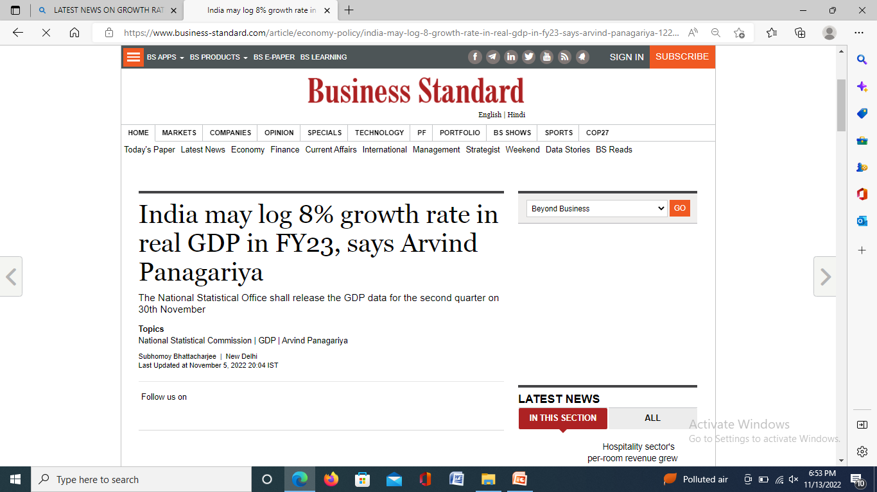
WHAT’S IN THE NEWS?

Slide 3
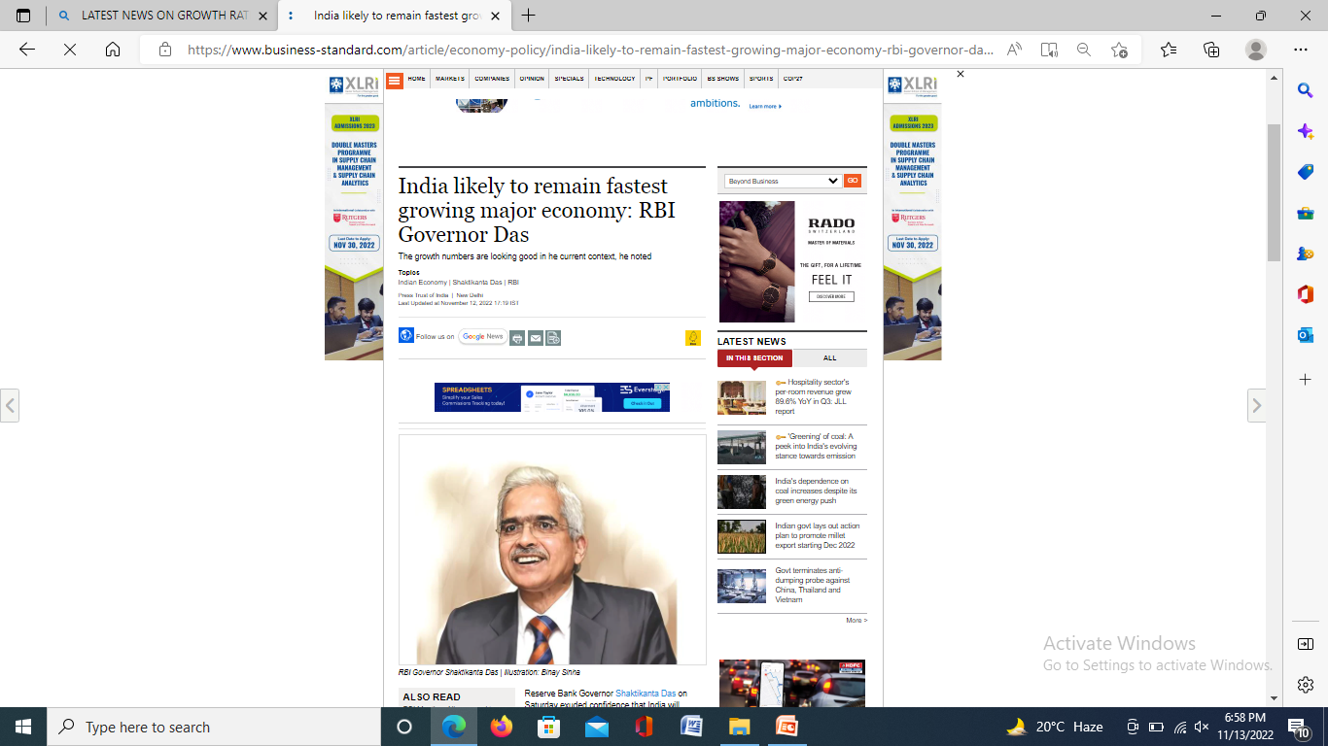
WHAT’S IN THE NEWS?

Slide 4
LEARING OUTCOMES
After the lecture, you will be able to
Explain various concepts of national income
Explain the concept of real and nominal national income.

Slide 5
NATIONAL INCOME
National income or product is the final figure you arrive at when you apply the measuring rod of money to the diverse apples, oranges, battleships and machines that any society produces with its land, labour and capital resources- Paul A. Samuelson

Slide 6
GROSS DOMESTIC PRODUCT (GDP)
GDP is the sum of money value of all final goods and services produced within domestic territories of a country during an accounting year.
GDP = C + I + G + (X – M)

Slide 7
CURRENT GDP STATUS
 | 2018-19 | 2019-20 | 2020-21
GDP (in crore) At constant prices | 13,992,914 | 14,515,958 | 13,558,473
GDP at current prices | 18,899,668 | 20,074,856 | 19,800,914

Slide 8
GDP
GDP at factor cost
GDP at market price
GDP at factor cost = GDP at market price - Indirect taxes + Subsidies

Slide 9
GROSS NATIONAL INCOME ( GNP)
Gross national income is the aggregate final output of citizens and businesses of an economy in a year.
GNP = GDP + NFIA

Slide 10
CURRENT STATUS OF GNP
 | 2018-19 | 2019-20 | 2020-21
GNP at current prices | 18,697,344 | 19,881,742 | 19,534,226
GNP at constant prices | 13,840,474 | 14,374,253 | 13,368,279

Slide 11
NET DOMESTIC PRODUCT (NDP)
NDP = GDP - Depreciation

Slide 12
CURRENT STATUS OF NDP
 | 2018-19 | 2019-2020 | 2020-21
NDP at current prices | 16,915,378 | 17,909,710 | 17,460,845
NDP at constant prices | 12,378,459 | 12,783,337 | 11,726,198

Slide 13
NET NATIONAL PRODUCT (NNP)
NNP = GDP – Depreciation + NFIA
NNP = GNP - Depreciation

Slide 14
CURRENT STATUS OF NNP
 | 2018-19 | 2019-20 | 2020-21
NNP at current prices | 16,713,054 | 17,716,597 | 17,194,158
NNP at constant prices | 12,226,019 | 12,641,633 | 11,536,004

Slide 15
NNP at factor cost (NATIONAL INCOME)
It is sum total of income earned by all people of the nation, within the national boundaries or abroad.
NNP at market price = GNP at market price – Depreciation
NNP at factor cost = NNP at market price – Indirect taxes + Subsidies

Slide 16
REAL AND NOMINAL NATIONAL INCOME
Real GDP = Nominal GDP/GDP deflator
GDP deflator the ratio of nominal GDP in a year to real GDP of the year.

Slide 17
PER CAPITA INCOME (PCI)
Per Capita Income =
National Income/Population

Slide 18
CURRENT STATUS OF PCI
 | 2018-19 | 2019-20 | 2020-21
Per capita income at current prices | 125946 | 132115 | 126855
At constant prices | 92133 | 94270 | 85110
Population (in millions) | 1327 | 1341 | 1355

Slide 19
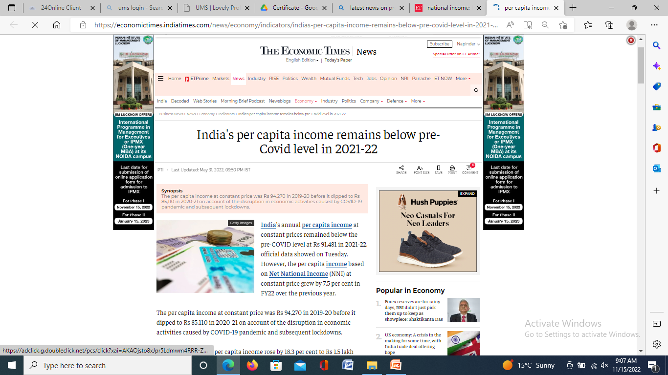
WHAT’S IN THE NEWS?

Slide 20
PERSONAL INCOME
Personal Income = National income – undistributed corporate profits – corporate taxes – social security contributions + transfer payments + interest on public debt

Slide 21
PERSONAL DISPOSAL INCOME
Personal Disposal Income =
Personal Income – Personal Taxes

Slide 22
FIND GDP at market price, NNP at factor cost, Personal income and PCI
NDP at market price = Rs. 2521700 crore
Net indirect taxes = Rs. 306087 crore
Net factor income from abroad = Rs. -41842 crore
Transfer payment = Rs. 78821 crore
Depreciation = Rs. 33873 crore
Total Population (in million) = 987

Slide 23
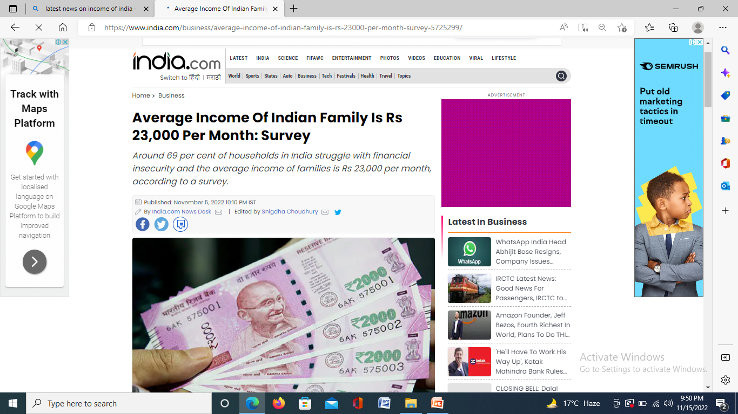
WHAT’S IN THE NEWS?

Slide 24
MEASUREMENT OF NATIONAL INCOME
Product (Output) Method
Income method
Expenditure method

Slide 25
PRODUCT METHOD
Two ways:
Final product method
Value added method

Slide 26
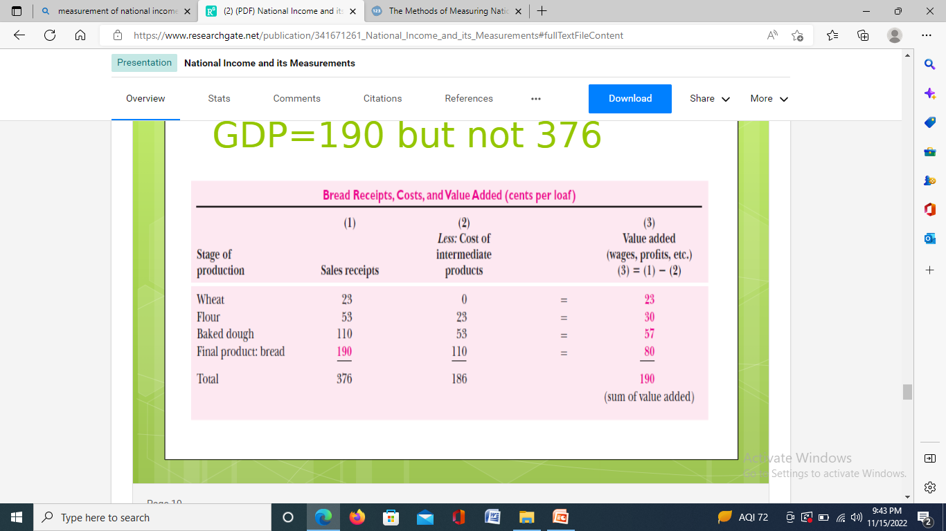
VALUE ADDED

Slide 27
LIMITATIONS
Problem of double counting
Not applicable to tertiary sector
Exclusion of non-marketed products

Slide 28
INCOME METHOD
GNP at factor cost = Rent + wages + interest + profit + other income + (income from abroad – payments made to foreigners) – transfer payments

Slide 29
LIMITATIONS
Exclusion of non-monetary income
Exclusion of non-marketed services

Slide 30
EXPENDITURE METHOD
Consumption expenditure
Investment expenditure
Government expenditure
Net exports

Slide 31
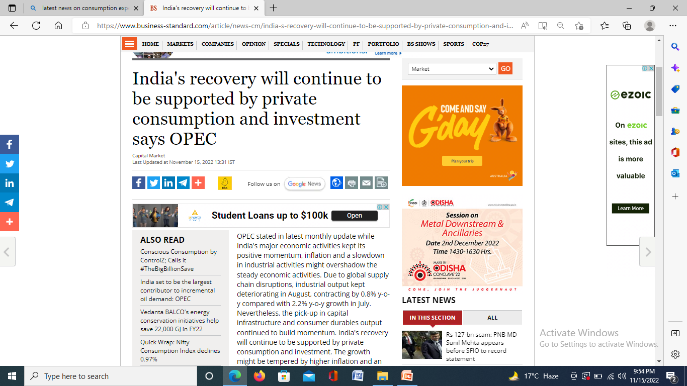
WHAT’S IN THE NEWS?

Slide 32
LIMITATIONS
Neglects barter system
Ignores own consumption
Affected by inflation

Slide 33
USES OF NATIONAL INCOME DATA
Economic planning
Indicator of economic growth
Comparing situations of economic growth of two different countries
Determining regional disparities

Slide 34
DIFFICULTIES IN MEASUREMENT
Non-monetised transactions
Unorganised sector
Multiple sources of earning
Categorization of goods and services
Inadequate data

Slide 35
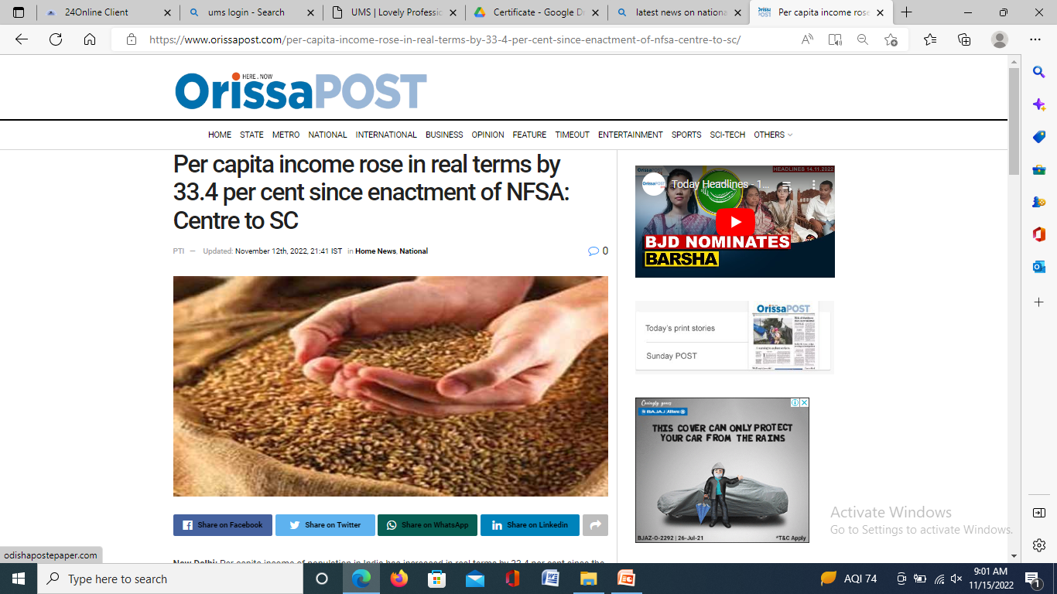
WHAT’S IN THE NEWS?

